Slide 1
An Introduction to NS-2*

Slide 2
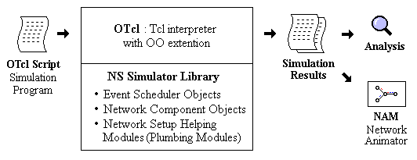
What is ns?
Object-oriented, discrete event-driven network simulator
Written in C++ and OTcl
By VINT: Virtual InterNet Testbed

Slide 3
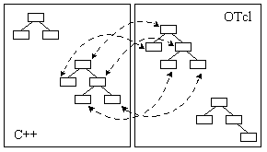
ns Architecture
Separate data path and control path implementations.

Slide 4
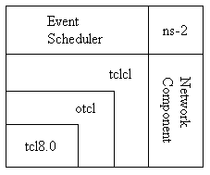
ns Architecture

Slide 5
Introduction
Discrete event simulator targeted at networking research and education
  Protocol design, traffic studies, etc
  Protocol comparison
  Wired and wireless networks
Back end is in C++ and front end is in oTcl
Provide a collaborative environment
  Open source, Freely distributed
    Share code, protocols, models, etc
    No code guarantee
  Easy comparison of similar protocols

Slide 6
Simulation Network
Wired Network
  Routing: Distance Vector, Link State
  Transportation: TCP and UDP
  Queuing disciplines: drop-tail, RED, FQ, SFQ, DRR, RR
  QoS: IntServ and DiffServ
Wireless
  Ad-hoc routing and mobile IP: AODV
  Sensor-MAC, WiMAX (new)
  Power control in wireless networks
Tracing, Visualization, Analysis, Other utilities

Slide 7
NS2 Functionalities
Traffic models and applications
  Web, FTP, Telnet, CBR, real time traffic
Transport protocols
  Unicast: TCP (Reno, New-Reno, Vegas, etc.), UDP
  Multicast: SRM
Routing and queuing
  Wired and ad-hoc routing and directed diffusion
  Queuing protocols: RED, drop-tail, etc
Physical media
  Wired (point-to-point, LANs), wireless (multiple propagation models), error models, satellite

Slide 8
How to work in NS2 ?
Download the software
Install NS2 in your home directory
  Compile the latest version of NS2
  Validate NS2
Create your topology
  Need to understand the real topology and the directory structure in NS2
  Modify the existing codes
    C++ and/or .tcl files
  Create your own .tcl script for this
Execute the script
  Analyze your result

Slide 9
Download and Installation of NS2
Select the Operating System
  NS2 is available for both Windows and Linux
  Linux is desirable as C++ compiler is free and easy to debug
Check your Hardware
  Processor speed, RAM, home directory space
    Minimum 400 MB space is required

Slide 10
Download and Installation of NS2
Install NS2 in your home directory
  Follow the instructions given in the course home page
  For trouble shooting refer to the links provided in the course home page
    http://nsnam.isi.edu/nsnam/index.php/Troubleshooting
  Else, do a google search
Solutions to most of the problems are available in the NS2 mailing list
  http://www.isi.edu/nsnam/ns/ns-lists.html

Slide 11
Create your Topology
Decide what do you want to simulate
  Wired or wireless network
  What are the protocols?
  How many nodes, what are the measuring parameters?
  What are the applications involved, etc?
Make a rough sketch of the topology
  Figure out the concerned files (C++ or .tcl)
  Based on the requirement do the following
    Edit the existing C++ files and/or the .tcl files
    You can create new C++ files

Slide 12
Data and Control Separation
oTCL in the Front End
  Control part of NS2
  Topology (Simulation scenario) configurations
  Event driven
    Periodic or Triggered action
  Manipulates existing C++ objects
  Easy to write and edit
C++ in the Back End
  Core of NS2, data part of NS2
  Easy to modify the code
    Not fully layered and structured
  Packet processing and execution

Slide 13
Directory Structure
Main directories
  bin, ns-2xx, lib, man, include, etc in ns2 home
ns-2.xx
  Readme file
  Makefile, installation file, tutorial, etc
  Source files related to the protocols
    All .cpp and .h files related needed for editing
  Need understanding of interaction among the functions/sub routines
  Not fully layered like QualNet

Slide 14
Compiling NS2
Create / Modify the C++ file
  If you are creating new C++ file, include the name of the new files in the Makefile
  If you are editing the existing C++ files, keep a copy of the original file
  Add comments to your modifications with date
Compile NS2
  After creation/editing, compile NS2 using
    (make clean;) make;
    Check for errors, if any and rectify

Slide 15
Executing NS2
Create your .tcl script as per your topology
Run the .tcl file using ns command
  Check which ns2 you are using
  Create a huge output file (trace file) to analyze
  Need to understand the file contents
  Perl scripts are also available to analyze the trace file
Analyze using nam
  Visual network animator
Single thread of control
  No locking or race conditions to worry about

Slide 16
Functional Diagram of NS2
Problem
Result
Analysis/debug
Topology
Modify
ns (.cpp/.tcl)
Setup/execute
simulation
with ns (.tcl)

Slide 17
Simulation with NS2
Create a New Event Scheduler (simulator env.)
Turn on Tracing
  Can use nam also
Topology Creation
  Create Nodes, Network, Queuing, etc.
  Setup Routing
  Send Data
    Create Transport Connection, Create Traffic, Start Applications
  Insert Errors
Analyze the Trace File

Slide 18
Event Scheduler
Event
  Generation of a packet, start/finish of transmission
Create a New Event Scheduler
  set ns [new Simulator]
Schedule Events
  $ns at <time> <event>
    <event>: any legitimate ns/tcl command
    $ns at 10.0 “finish”
Start Scheduler
  $ns run

Slide 19
Tracing and Analyzing
Packet Tracing
  On all links
    $ns trace-all [open cwnd.tr w]
  On one specific link
    $ns trace-queue $n0 $n1$tr
<Event> <time> <from> <to> <pkt> <size> -- <fid> <src> <dst> <seq> <attr>
  + 1 0 2 cbr 210 ------- 0 0.0 3.1 0 0
  - 1 0 2 cbr 210 ------- 0 0.0 3.1 0 0
  r 1.00234 0 2 cbr 210 ------- 0 0.0 3.1 0 0
Event Tracing
  Record “event” in trace file
    $ns eventtrace-all
  E 2.267203 0 4 TCP slow_start 0 210 1

Slide 20
Topology Creation
Create Nodes
  set n0 [$ns node]
  set n1 [$ns node]
Assign Links and Queuing
  $ns <link_type> $n0 $n1 <bandwidth> <delay> <queue_type>
    <link_type>: duplex-link, simplex-link
    <queue_type>: DropTail, RED, CBQ, FQ, SFQ, DRR, diffserv RED queues
    Viz: $ns duplexlink $n0 $n1 1Mb 10ms DropTail
      Link between n0 and n1 is duplex, 1Mbps capacity, 10msec delay and queue is Drop Tail

Slide 21
Setup Routing
Unicast
  $ns rtproto <type>
    <type>: Static, Session, DV, cost, multi-path
Multicast
  $ns multicast (right after [new Simulator])
  $ns mrtproto <type>
    <type>: CtrMcast, DM, ST, BST
Other Types of Routing Supported
  Source routing, Hierarchical routing

Slide 22
Sending Data
Create UDP Agent and Attach
  set udp0 [new Agent/UDP]
  $ns attach-agent $n0 $udp0
Create CBR Traffic
  set src [new Application/Traffic/CBR]
    set cbr0 [new Application/Traffic/CBR]
    $cbr0 set packetSize_ 500
    $cbr0 set interval_ 0.005
    $cbr0 attachagent $udp0
Create Traffic Sink and Attach
  set null [new Agent/Null]
  $ns attach-agent $n1 $null

Slide 23
Sending Data
Create Exponential or Pareto on-off
  set src [new Application/Traffic/Exponential]
  set src [new Application/Traffic/Pareto
Connect two Agents
  $ns connect $udp0 $null
Start and Stop of Data
  $ns at 0.5 “$cbr0 start”
  $ns at 4.5 “$cbr0 stop”
Create TCP Agent and Attach
  set tcp0 [new Agent/TCP]
  $ns attach-agent $n0 $tcp0

Slide 24
Sending Data
Create Traffic Sink and Attach
  set null0 [new Agent/TCPSink]
  $ns attach-agent $n1 $null0
Connect the Agents
  $ns connect $tcp0 $null0
Traffic on Top of TCP
  FTP
    set ftp [new Application/FTP]
    $ftp attach-agent $tcp0
  Telnet
    set telnet [new Application/Telnet]
    $telnet attach-agent $tcp0

Slide 25
Inserting Errors
Creating Error Module
  set loss_module [new ErrorModel]
  $loss_module set rate_ 0.01
  $loss_module unit pkt
  $loss_module ranvar [new RandomVariable/Uniform]
  $loss_module drop-target [new Agent/Null]
Inserting Error Module
  $ns lossmodel $loss_module $n0 $n1

Slide 26
Analyze the Trace File
Trace files are huge in size
  Only redirect the parameters you want to measure
  Traces begin with a single character or abbreviation
  It indicates the type of trace, followed by a fixed or variable trace format
Perl scripts are available to analyze trace files
Refer for the details
  http://nsnam.isi.edu/nsnam/index.php/NS-2_Trace_Formats

Slide 27
Hello World – Interactive mode
bash-shell$ ns
% set ns [new Simulator]
_o3
% $ns at 1 “puts \“Hello World!\””
1
% $ns at 1.5 “exit”
2
% $ns run
Hello World!
bash-shell$

Slide 28
Hello World – Batch mode
simple.tcl
  set ns [new Simulator]
  $ns at 1 “puts \“Hello World!\””
  $ns at 1.5 “exit”
  $ns run
bash-shell$ ns simple.tcl
Hello World!
bash-shell$

Slide 29
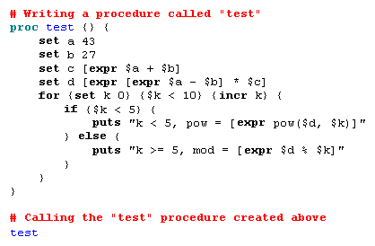
Basic Tcl: ex-tcl.tcl

Slide 30

Basic OTcl
Class Mom
Mom instproc greet {} {
$self instvar age_
puts “$age_ years old mom: How are you doing?”
}
Class Kid -superclass Mom
Kid instproc greet {} {
$self instvar age_
puts “$age_ years old kid: What’s up, dude?”
}
set mom [new Mom]
$mom set age_ 45
set kid [new Kid]
$kid set age_ 15
$mom greet
$kid greet

Slide 31
NS-2 Generic Script Structure
Create Simulator object
[Turn on tracing]
Create topology
[Setup packet loss, link dynamics]
Create routing agents
Create application and/or traffic sources
Post-processing procedures (i.e. nam)
Start simulation

Slide 32
Step1: Create Simulator Object
Create event scheduler
  set ns [new Simulator]

Slide 33
Step2: Tracing
Insert immediately after scheduler!
Trace packets on all links
  set nf [open out.nam w]
  $ns trace-all $nf
  $ns namtrace-all $nf

Slide 34
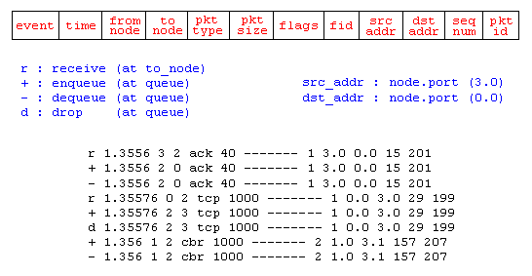
Step2: Tracing

Slide 35
NS-2 Generic Script Structure
Create Simulator object
[Turn on tracing]
Create topology
[Setup packet loss, link dynamics]
Create routing agents
Create application and/or traffic sources
Post-processing procedures (i.e. nam)
Start simulation

Slide 36
Step 3: Create network
Two nodes, One link
n0
n1

Slide 37
Step 3: Create Network
n0
Nodes
  set n0 [$ns node]
  set n1 [$ns node]
Links and queuing
  $ns duplex-link $n0 $n1 1Mb 10ms RED
  $ns duplex-link $n0 $n1 <bandwidth> <delay> <queue_type>
  <queue_type>: DropTail, RED, etc.
n1

Slide 38
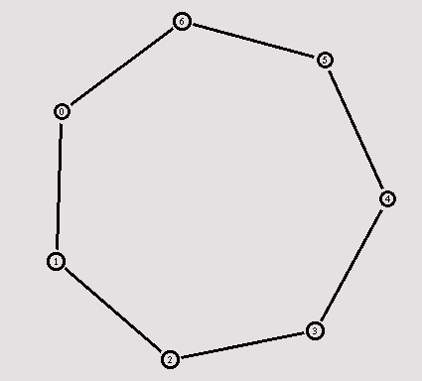
Creating a larger topology
  for {set i 0} {$i < 7} {incr i} {
    set n($i) [$ns node]
    }
    for {set i 0} {$i < 7} {incr i} {
    $ns duplex-link $n($i) $n([expr ($i+1)%7]) 1Mb 10ms RED
    }

Slide 39
NS-2 Generic Script Structure
Create Simulator object
[Turn on tracing]
Create topology
[Setup packet loss, link dynamics]
Create routing agents
Create application and/or traffic sources
Post-processing procedures (i.e. nam)
Start simulation

Slide 40
Step 4: Network Dynamics
Link failures
  Hooks in routing module to reflect routing changes
$ns rtmodel-at <time> up|down $n0 $n1
For example:
$ns rtmodel-at 1.0 down $n0 $n1
$ns rtmodel-at 2.0 up $n0 $n1

Slide 41
Step 5: Creating UDP connection
  set udp [new Agent/UDP]
  set null [new Agent/Null]
  $ns attach-agent $n0 $udp
  $ns attach-agent $n1 $null
  $ns connect $udp $null
udp
n0
n1
null

Slide 42
Step 6: Creating Traffic
(On Top of UDP)
cbr
CBR
  set cbr [new Application/Traffic/CBR]
  $cbr set packetSize_ 500
  $cbr set interval_ 0.005
  $cbr attach-agent $udp
udp
n0
n1
null

Slide 43
Creating TCP connection
  set tcp [new Agent/TCP]
  set tcpsink [new Agent/TCPSink]
  $ns attach-agent $n0 $tcp
  $ns attach-agent $n1 $tcpsink
  $ns connect $tcp $tcpsink
tcp
n0
n1
sink

Slide 44
Step 6: Creating Traffic
(On Top of TCP)
ftp
FTP
  set ftp [new Application/FTP]
  $ftp attach-agent $tcp
Telnet
  set telnet [new Application/Telnet]
  $telnet attach-agent $tcp
tcp
n0
n1
sink

Slide 45
Recall: Generic Script Structure
set ns [new Simulator]
[Turn on tracing]
Create topology
[Setup packet loss, link dynamics]
Create agents
Create application and/or traffic sources
Post-processing procedures (i.e. nam)
Start simulation
Examples

Slide 46
Post-Processing Procedures
Add a 'finish' procedure that closes the trace file and starts nam.
proc finish {} {
global ns nf
$ns flush-trace
close $nf
exec nam out.nam &
exit 0
}

Slide 47
Run Simulation
Schedule Events
$ns at <time> <event>
  <event>: any legitimate ns/tcl commands
$ns at 0.5 "$cbr start"
$ns at 4.5 "$cbr stop“
Call ‘finish’
$ns at 5.0 "finish"
Run the simulation
$ns run

Slide 48
Recall: Generic Script Structure
set ns [new Simulator]
[Turn on tracing]
Create topology
[Setup packet loss, link dynamics]
Create routing agents
Create application and/or traffic sources
Post-processing procedures (i.e. nam)
Start simulation
Examples

Slide 49
Visualization Tools
nam-1 (Network AniMator Version 1)
  Packet-level animation
  Well supported by ns
xgraph
  Simulation results

Slide 50
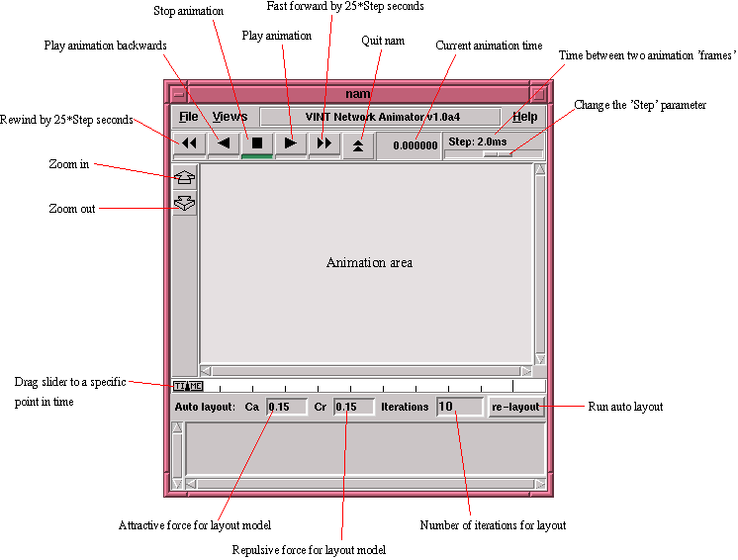

Slide 51
nam Interface: Nodes
Color
  $node color red
Shape (can’t be changed after sim starts)
  $node shape box (circle, box, hexagon)
Label (single string)
  $ns at 1.1 “$n0 label \”web cache 0\””

Slide 52
nam Interfaces: Links
Color
  $ns duplex-link-op $n0 $n1 color "green"
Label
  $ns duplex-link-op $n0 $n1 label “backbone"

Slide 53
nam Interface: Topology Layout
“Manual” layout: specify everything
  $ns duplex-link-op $n(0) $n(1) orient right
  $ns duplex-link-op $n(1) $n(2) orient right
  $ns duplex-link-op $n(2) $n(3) orient right
  $ns duplex-link-op $n(3) $n(4) orient 60deg
If anything missing → automatic layout

Slide 54
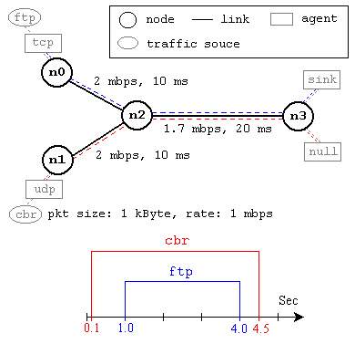
Simulation Example

Slide 55
Examples
#Reference Link http://nile.wpi.edu/NS/simple_ns.html#Create a simulator object

Slide 56
Example :ns-simple
set ns [new Simulator]
#Define different colors for data flows (for NAM)
$ns color 1 Blue
$ns color 2 Red
#Open the NAM trace file
set nf [open out.nam w]
$ns namtrace-all $nf

Slide 57
Cont..d
#Define a 'finish' procedure
proc finish {} {
global ns nf
$ns flush-trace
#Close the NAM trace file
close $nf
#Execute NAM on the trace file
exec nam out.nam &
exit 0
}

